Slide 1

Career Development Seminar
Instructor: Margaret Roberts

Slide 2

About me…professionally
leading career management at ESB since July 2002
BA, Anthropology from UCSB in 1992
Grad student in Pacific’s Benerd School of Education – pursuing an MA in Educational Administration & Leadership
10 years in recruiting & staffing industry out of college (general staffing, high tech & venture capital)
Freelance resume writer for executives and experienced professionals since 2001
Certified Emotional Intelligence Strategist/Coach (2008)
Trained in behavioral interviewing, career coaching and counseling

Slide 3
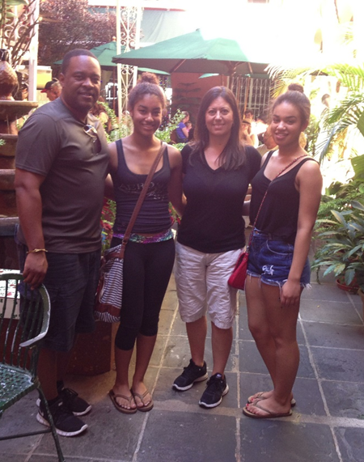




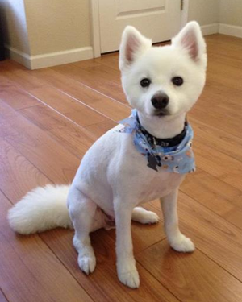
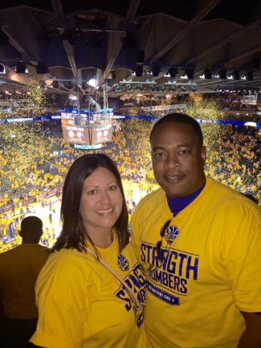

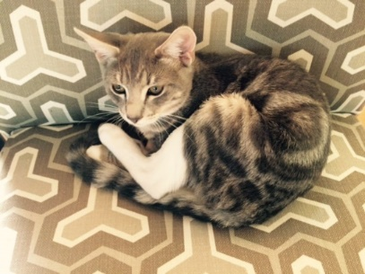
In my free time: family, Golden State Warriors basketball, SF Giants, Gardening, travel, genealogy!

Slide 4
Outcomes for Career Class
produce a professional resume
develop interviewing skills through role playing, mock interviews and informational interviews
articulate professional brand through the development of a personal commercial and LinkedIn profile
understand the importance of and develop networking and professional communication skills as it relates to your career success
articulate career goals and an action plan with a 3 year future focus

Slide 5
Delivery of Career education
Presentation/Discussion of key topics in class and online
Assignments that engage you in career planning, networking, and skill building
Guest Speakers, panels, etc.
Online content quizzes to ENSURE MASTERY OF CONTENT
NO EXAMS

Slide 6
Expectations of Students
Treat this class like a JOB or INTERNSHIP
Attend EVERY class
Be on time and BE ENGAGED
Turn off all electronic / computer devices during class except when advised
Turn in all assignments ON TIME
Dress appropriately for guest speaker visits (business casual! See syllabus)
Do not leave early and disrupt our guests
Ask questions and learn from speakers
participate in discussions

Slide 7
What’s my role? Facilitator, guide, coach, connector
Introduce tools, methods and strategies that are key to managing your career
Guide you in navigating the internship / job search process by mastering the tools / methods
Coach you in your individual career exploration and development to maximize your potential
Connect you to resources (alumni / employers) who can help you realize your goals

Slide 8
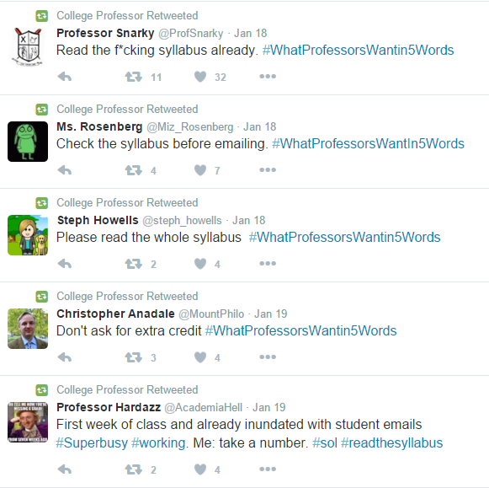

Slide 9

Take a few minutes now to…

Slide 10

Syllabus quiz

Slide 11

Question 1
How many points are required to pass this course?

Slide 12

Question 2
How many class session may you miss and STILL receive a pass grade?

Slide 13
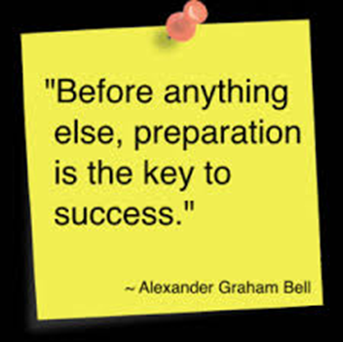
Question 3
What must you do if you are going to miss a class session?

Slide 14
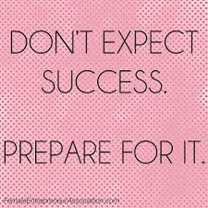
Question 4
When are you required to wear business casual attire to class?

Slide 15

Question 5
What scale is used to grade this course?

Slide 16

Question 6
When is use of technology acceptable in class? When is it not acceptable?

Slide 17

Question 7
We will develop interview skills through what three (3) types of exercises?

Slide 18

Question 8
What assignments are due during spring break?

Slide 19

Question 9
Where do you find the weekly career articles posted to read and submit your reflections?

Slide 20
Question 10
What career event is required?

Slide 21

When all else fails…
Ask questions!

Slide 22
Applying business principles to our career mindset
Securing an internship or job is a process, not an event.
knowledge and skills gained from marketing, management & HR (org behavior, Hr Mgmt, strategy, entrepreneurship), and finance courses can help you in this process.
Adapt the concepts to your own business (you) to start and build a successful career.

Slide 23
The Job Search from a marketing perspective….
Your job search is a campaign
You are the product (resume, cover letters, linkedin profile is your marketing collateral)
You have to canvas the job market (place) and promote yourself (networking, applications)
You must articulate your qualifications (positioning) (interview, interview, interview)
You must close the sale (price)! (negotiate the offer)

Slide 24
Resumes & Cover Letters
resumes
Cover letters
Secure interviews, not offers
Tell a story
Sell your accomplishments
First impression to employers
One size doesn’t fit all
Use power language / action verbs
Know your audience!
Compare your qualifications to job descriptions – gaps?
Professional communication – format accordingly
Grammar, spelling matters here too!
Do your homework – address to a person
Don’t regurgitate resume bullets, but expand on key stories
Focus on how you can add value to the company
Keep it brief – one page, coherent, concise, confident communication

Slide 25
Most people aren’t very good at writing their own resume
However, that’s no excuse for having a crappy resume!
Get help!!! Start with the online resources provided on canvas!
Continuously fine tune and enhance it as you build skills and achievements over time – it’s not a static document!
BUT…. Don’t obsess over it – you don’t have to accept ever piece of advice that you receive

Slide 26
Steps to getting your resume approved for tiger jobs
Get feedback on your revised draft (incorporate the recommendations from this course before you visit Crc or CMC)
Make improvements and have your updated resume reviewed (email ok) for final approval
Upload to tiger jobs so you can use it!

Slide 27
Cover letters - why they aren’t an assignment in this class
You and I will both get more value out of reviewing and enhancing a cover letter that you are actually going to use
You will put more effort into writing a cover letter that you want to send to a real employer / job / internship
If you need help with this, make an appointment to meet with me and review a draft you have written for a real opportunity

Slide 28
Expectations for the next 3 weeks
THIS WEEK – Jan 23-27:
Watch/listen to the audio presentations on resumes & cover letters
Sign up for a mock interview slot via Tiger jobs (update your profile and upload resume draft!)
NEXT WEEK – jan 30-feb 3:
develop or refine your draft resume and take with you for feedback at a drop in session (cmc or crc)
Prepare for your mock interview!
Week of feb 6:
No class – review the online content!!! Complete quiz.
Conduct your mock interview. Complete reflection.

